Slide 1
Metro Rail Ticket Mangement System

Slide 2
Contributors to this Project
02
01
03
Nadiya Noor
Safkat Khan
ID : 22-46454-1
Section : P
ID : 22-46392-1
Section : P
TAFSIRUL ISLAM SHAFIN
ID : 22-47325-1
Section : P

Slide 3

01
Introduction

Slide 4
Introduction
A metro rail ticket management system (MRTTMS) is a computerized system that manages the ticketing process for metro rail passengers. It encompasses various functionalities, including ticket issuance, fare calculation, revenue tracking, and passenger information management. An effective MRTTMS plays a crucial role in streamlining metro operations, enhancing passenger satisfaction, and optimizing revenue collection.
Revolutionize your urban commute with our Metro Rail Ticket Management System. Enjoy seamless online booking, real-time updates, and advanced security features for a stress-free journey. Designed with commuters in mind, this system ensures a convenient and efficient experience, heralding a new era in metro rail transportation. Say goodbye to queues and welcome the future of hassle-free travel."

Slide 5
Key Features
User Authentication: | User authentication to ensure that only authorized individuals can access the system
Online Booking: | Enabled commuters to book tickets conveniently through a user-friendly online platform.
Real-time Seat Availability: | Provided instant updates on available seats, allowing users to choose preferred seating.
Subscription Services: | Provided subscription plans for regular commuters, offering discounts or special privileges.
Role-Based Access Control: | Utilized Role-Base access control for Passenger, Employee, Staff and other
Notification Center: | Implemented a centralized notification center for important announcements, alerts, and personalized messages.
Secure Payment Options: | Implemented secure and diverse payment methods to ensure safe transactions.
Feedback and Ratings: | Allow users to provide feedback and ratings for services, contributing to system improvements.

Slide 6
02
Benefits:

Slide 7
Benefits
A metro train system is pivotal for urban efficiency, providing reliable, cost-effective mass transit that alleviates traffic congestion, promotes sustainability, and enhances accessibility. Safety features, economic stimulation, and optimized land use contribute to transformative urban landscapes, fostering growth and improving the overall quality of life.
The metro train system's impact extends beyond transportation, creating economic stimulation and optimizing land use. By fostering development around stations, it transforms urban landscapes, contributing to a more sustainable and vibrant environment. This, in turn, improves residents' quality of life while supporting a healthier and economically prosperous urban ecosystem.

Slide 8
More Benefits
Faster commutes: Less traffic & shorter travel times.
Cleaner cities: Reduced pollution & noise from fewer cars.
Easier access: Connects neighborhoods, helps disabilities & budget-friendly.
Better economy: Creates jobs, boosts business & tourism.
Stress-free travel: Comfortable, relaxing, and predictable journeys.
Environmentally friendly: Lowers emissions & combats climate change.
Urban boost: Sparks development, creates vibrant hubs.
Safety first: Secured stations, calmer commutes.
Skip the parking: Stress-free travel, ditch the parking woes.
Connect & explore: Meet locals, discover hidden gems.
Tourist-friendly: Easy access to city hotspots.
Equal access: Affordable travel for all, fostering inclusivity.
Healthy city: More walking, cleaner air, better health.

Slide 9
03
User Interface :

Slide 10
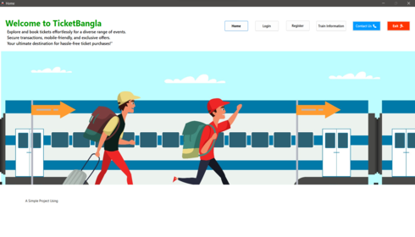
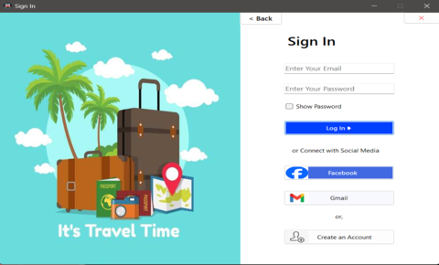
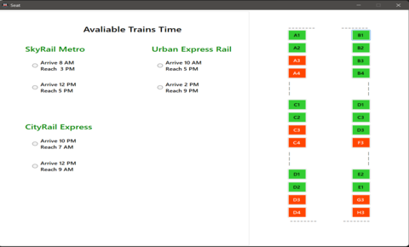
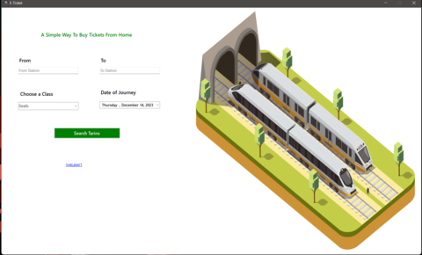
1
2
4
3

Slide 11
04
Booking Process:

Slide 12

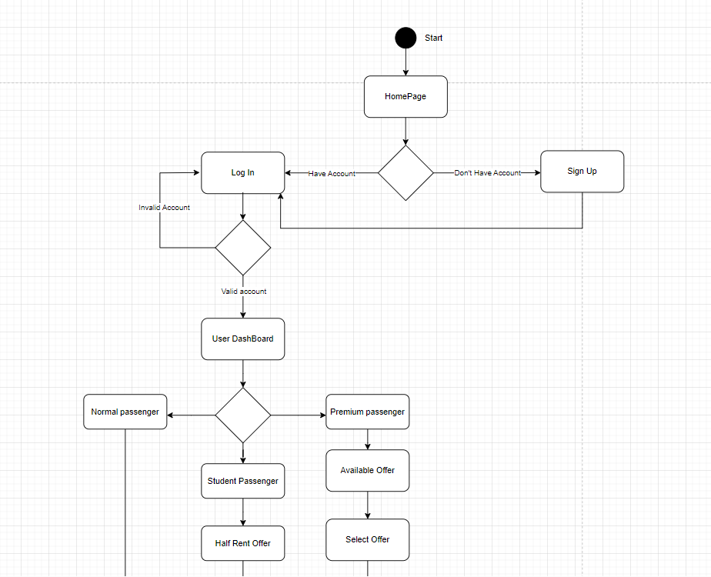
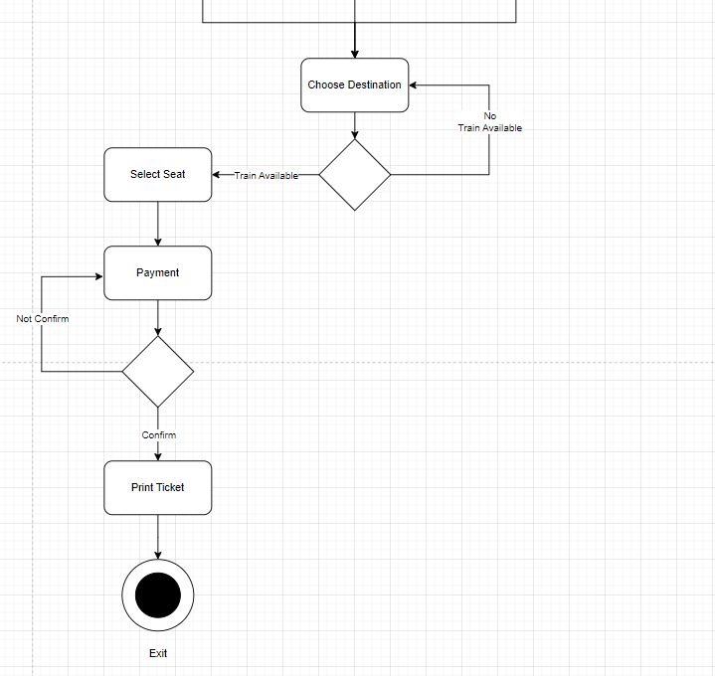

Slide 13
05
Real-Time Updates:

Slide 14
In the world of modern travel, staying informed
is paramount. Our Train Ticket Management
System goes beyond the booking process,
providing passengers with real-time updates
to ensure a journey that is not only planned but
also adaptable and stress-free.
Our system provides passengers with up-to-the
minute schedule information. Whether it’s a
change in departure time or a delay, passengers
are immediately notified, allowing them to plan
accordingly and stay one step ahead.
We understand that time is of the essence. In
the event of delays, our system sends
prompt notifications, keeping passengers
Informed about any changes and minimizing
inconvenience.

Slide 15
06
Security Measures:

Slide 16
Secure Payment Gateway: We integrate a robust and trusted payment gateway that complies with Payment Card Industry Data Security Standard requirements.
Data Privacy Complianc: Our system adheres to data protection regulations and follows best practices for data privacy.
Regular Security Audits: We conduct regular security audits and vulnerability assessments to identify and address potential weaknesses in our system.
Data Backups : Regular automated backups of passenger data are performed to ensure data integrity and availability
Continuous Monitoring : Our system employs continuous monitoring tools to detect and respond to suspicious activities in real-time

Slide 17
07
Future Developments:

Slide 18
Smart Ticketing Integration :
Explore integration with smart
ticketing technologies, such as NFC
or RFID, to enable passengers to
access trains seamlessly with
electronic tickets, reducing reliance
on physical tickets.
Personalized Travel Recommendations :
Implement an intelligent
recommendation system that offers
personalized travel suggestions,
including optimal routes, preferred
seating, and additional services based
on user preferences and travel history.

Slide 19
08
Conclusion :

Slide 20
The Train Ticket Management System redefines travel, providing an efficient, secure, and seamless experience. With a streamlined booking process, real-time updates, and mobile-friendly features, passengers enjoy a hassle-free journey. Robust security measures ensure the protection of personal information and transactions. Future enhancements, including smart ticketing, personalized recommendations, and augmented reality assistance, promise a continually evolving and personalized travel experience. Scalability options like cloud-based infrastructure and microservices ensure optimal performance as the system grows. In essence, the system is a comprehensive solution, transforming travel into a stress-free, informed, and enjoyable experience for passengers from start to finish.

Slide 21
THANK YOU

